Slide 1
Storytelling – My Internship Journey
Narrated and Presented by Vaishakhi Shah
Portfolio Management Intern

Slide 2

The Tale begins and follows…
1
3
- Introduction
- Overview
- Data Analysis and Visualization
- Ad hoc Projects
2
4
- Journey So Far
- Key Learnings and Takeaways
- Milestones Achieved
- Progressive Path

Slide 3


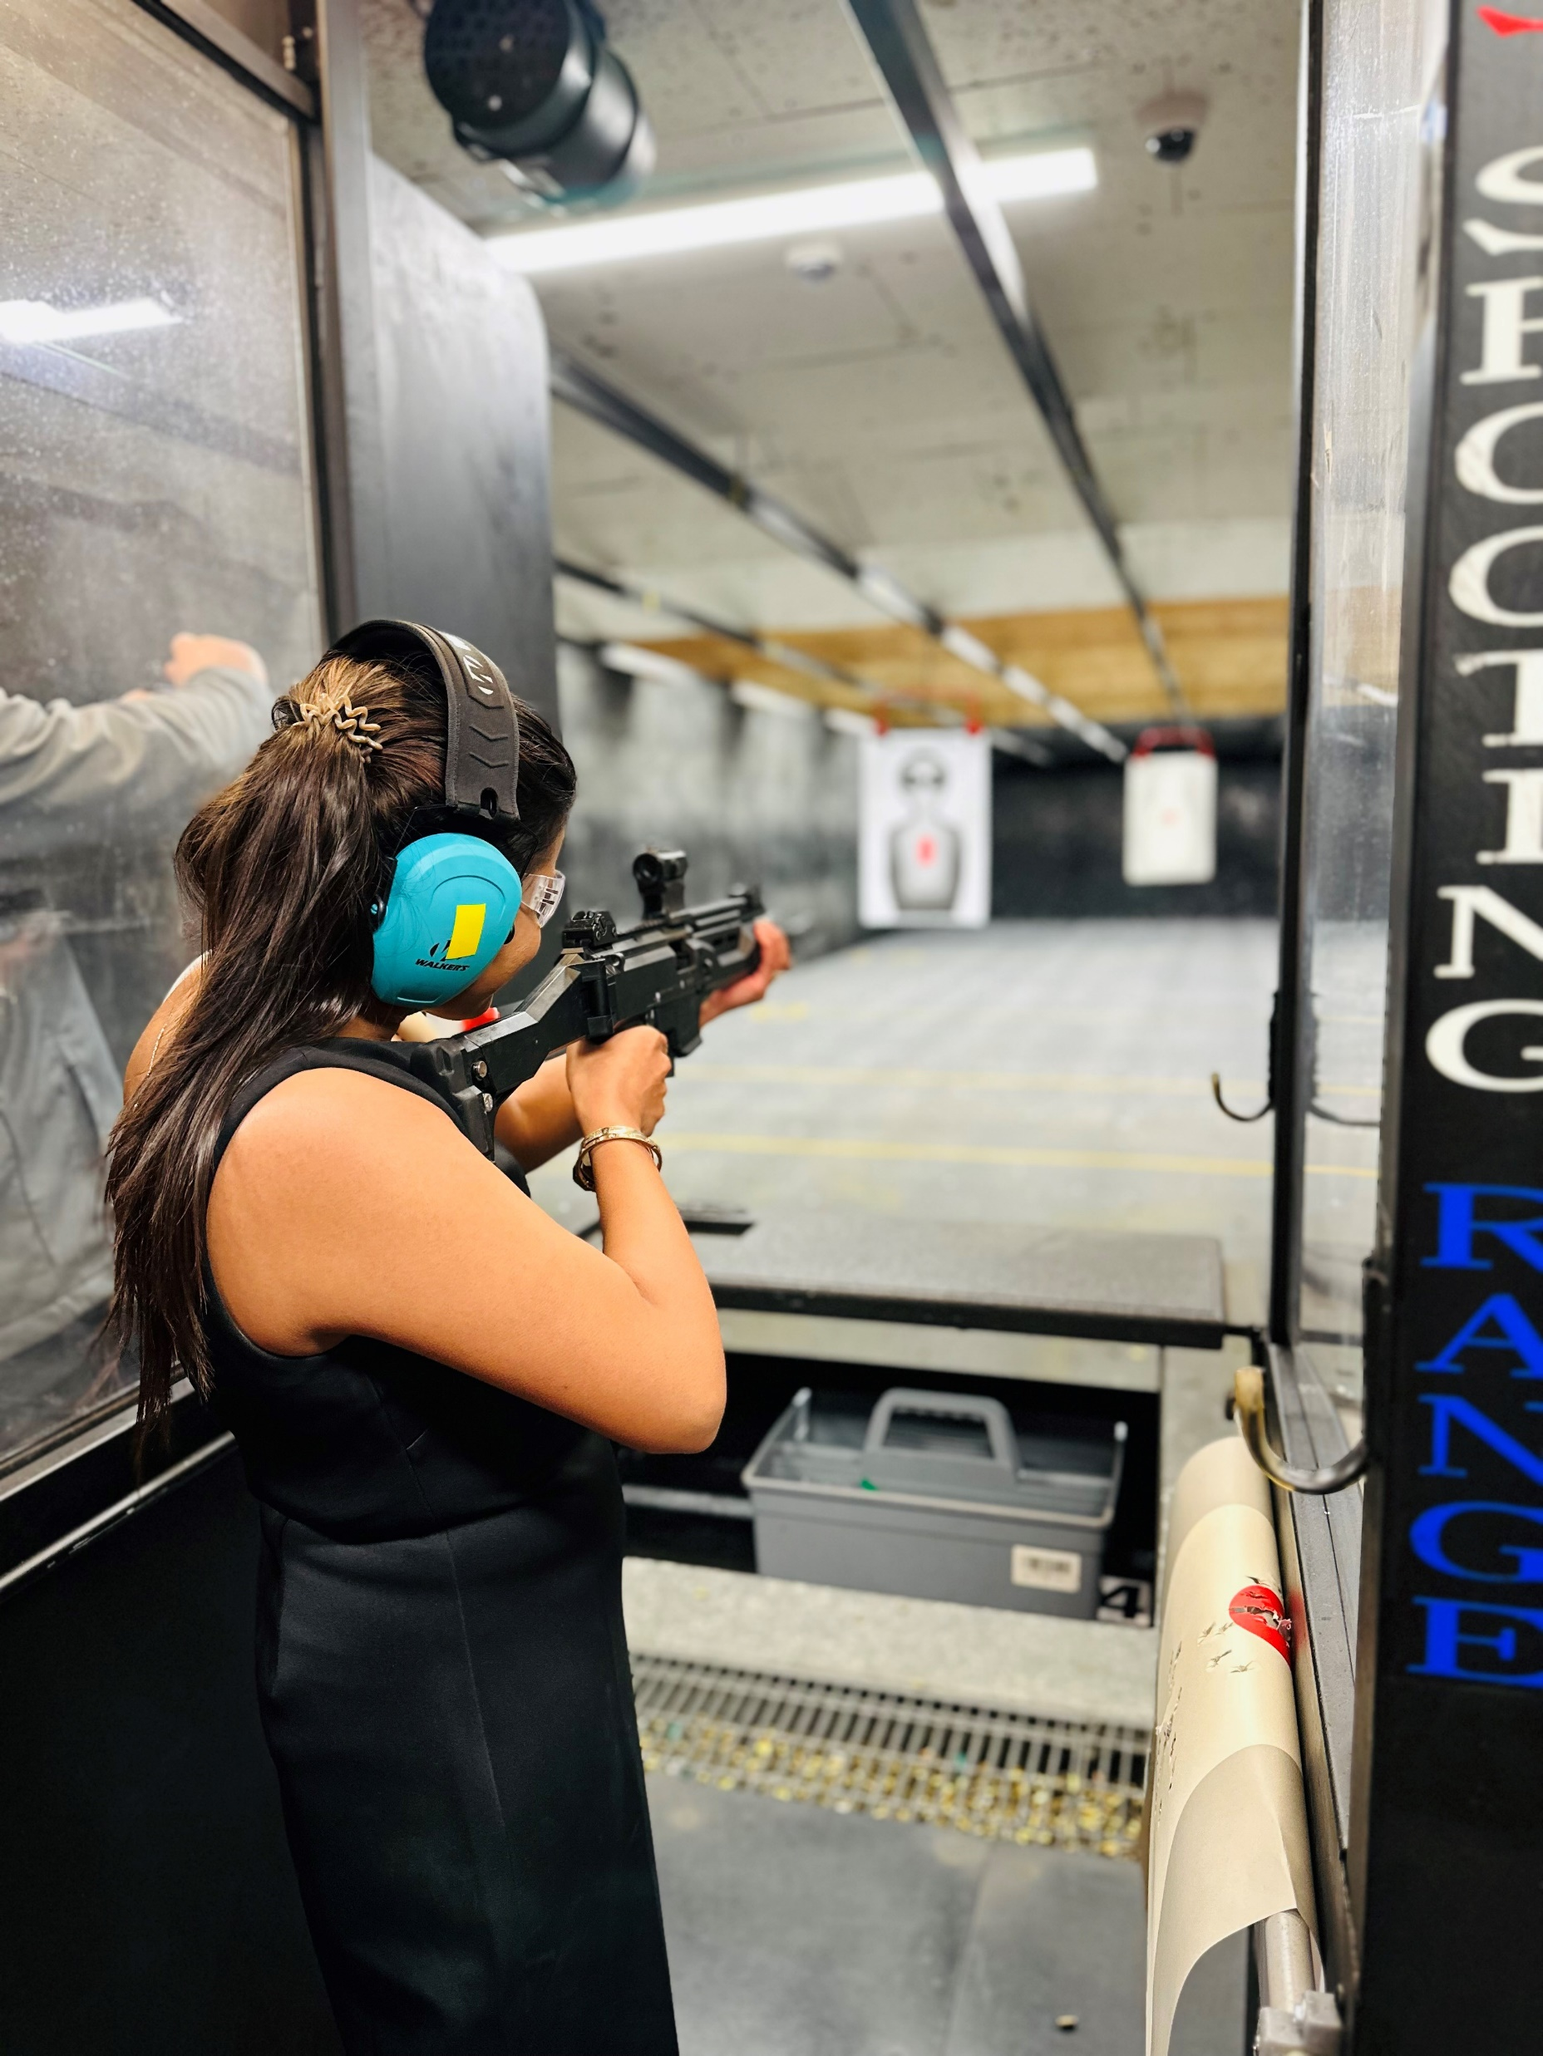
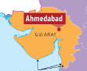

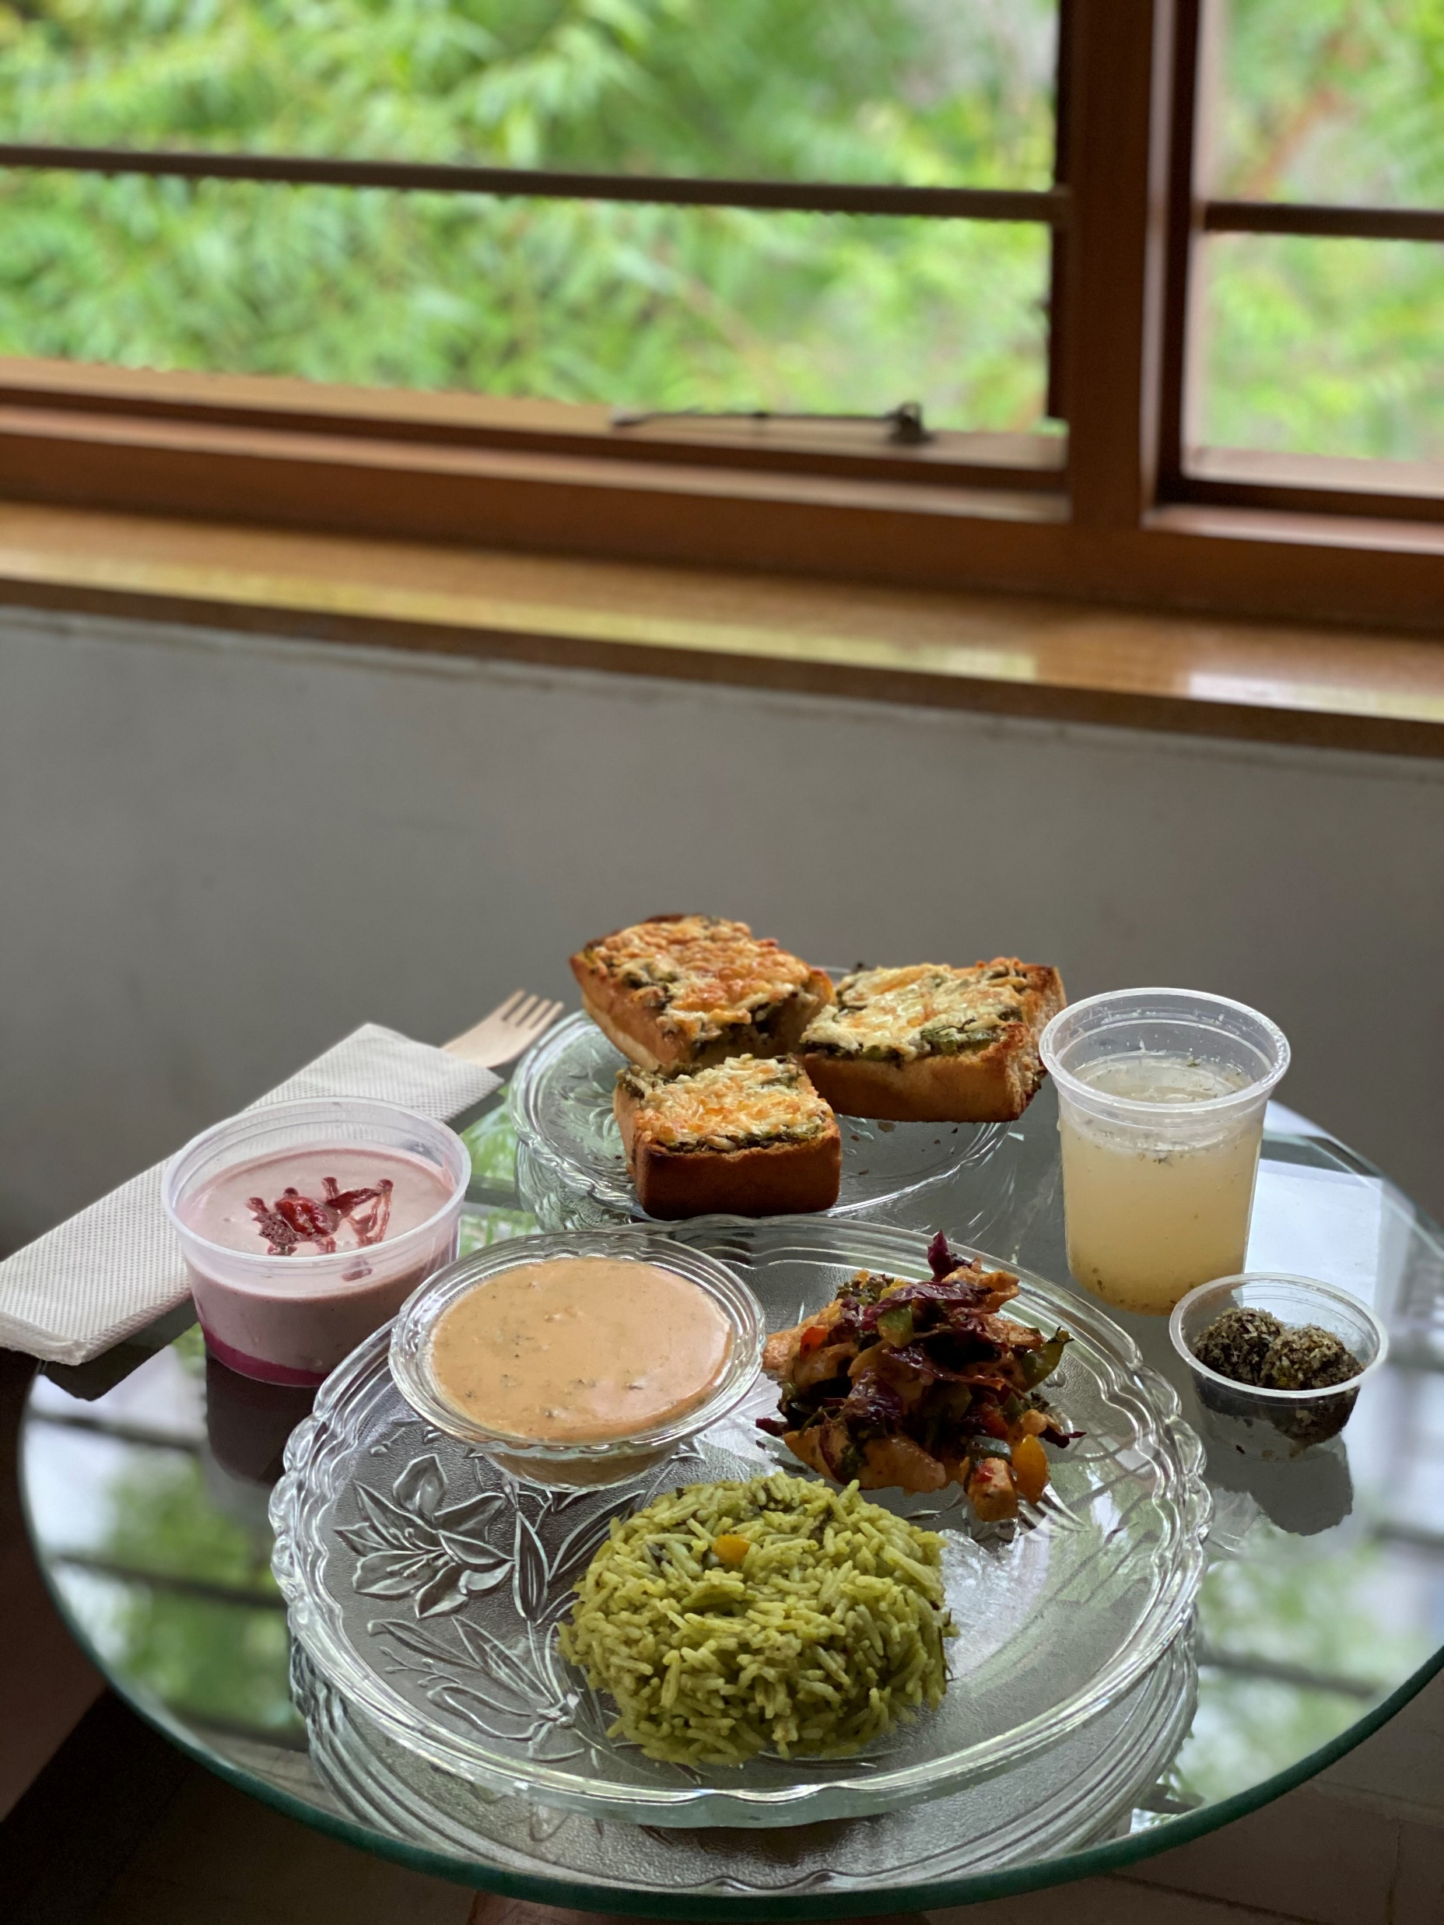
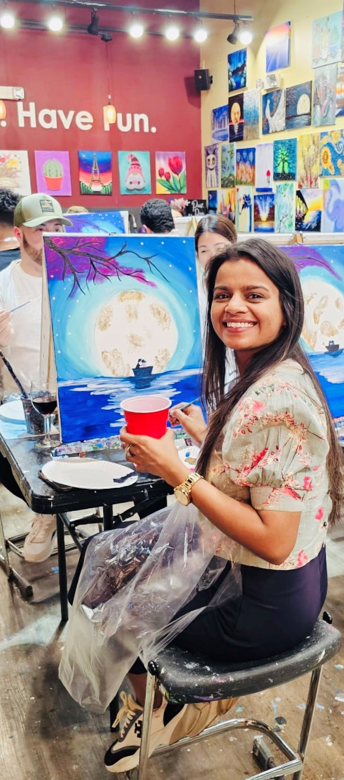
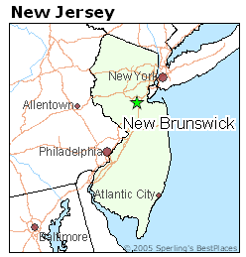
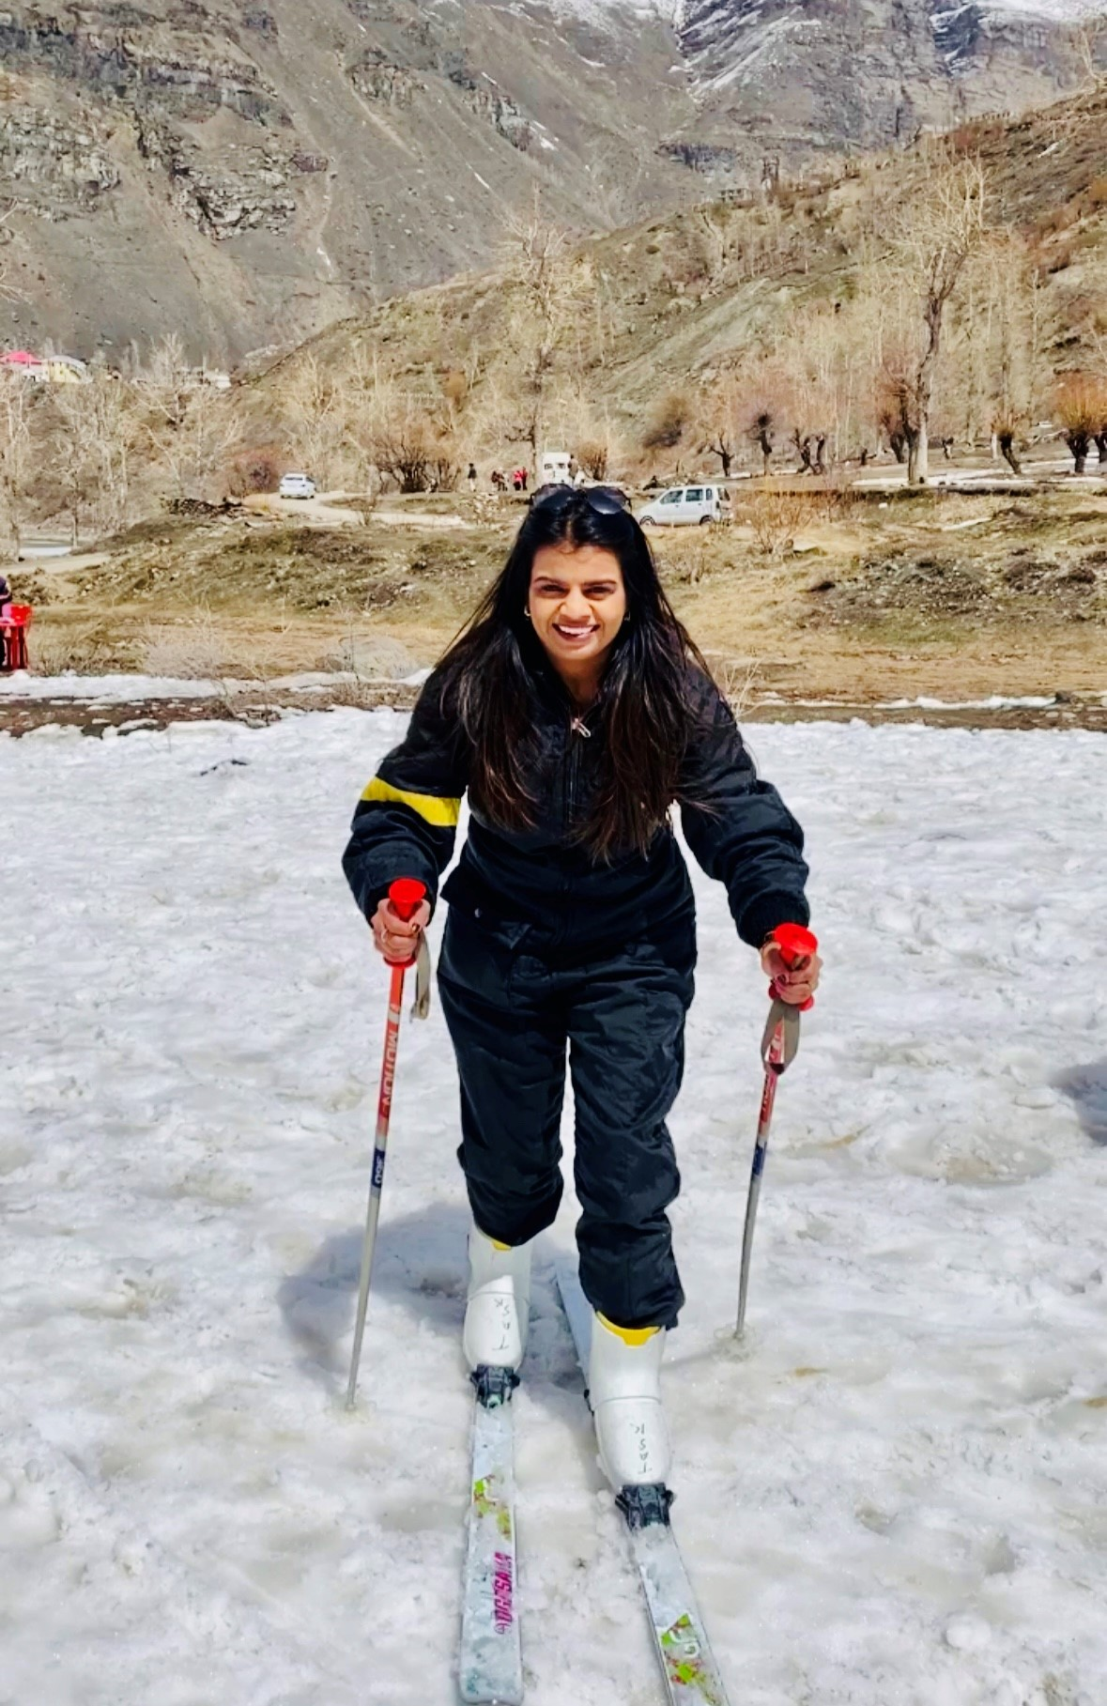


Introduction

Slide 4
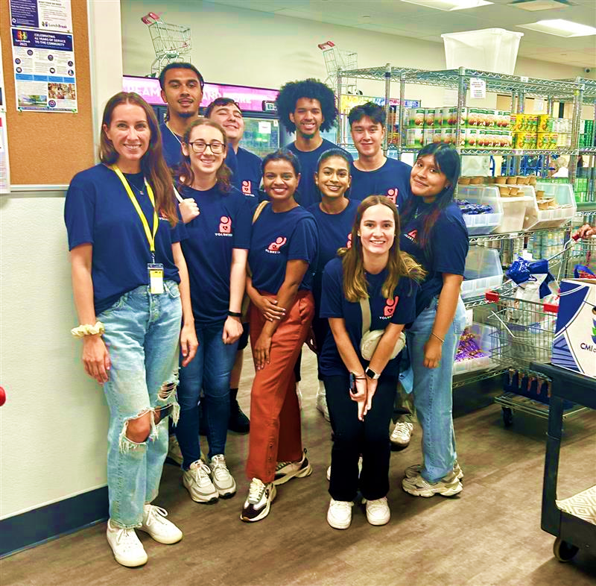



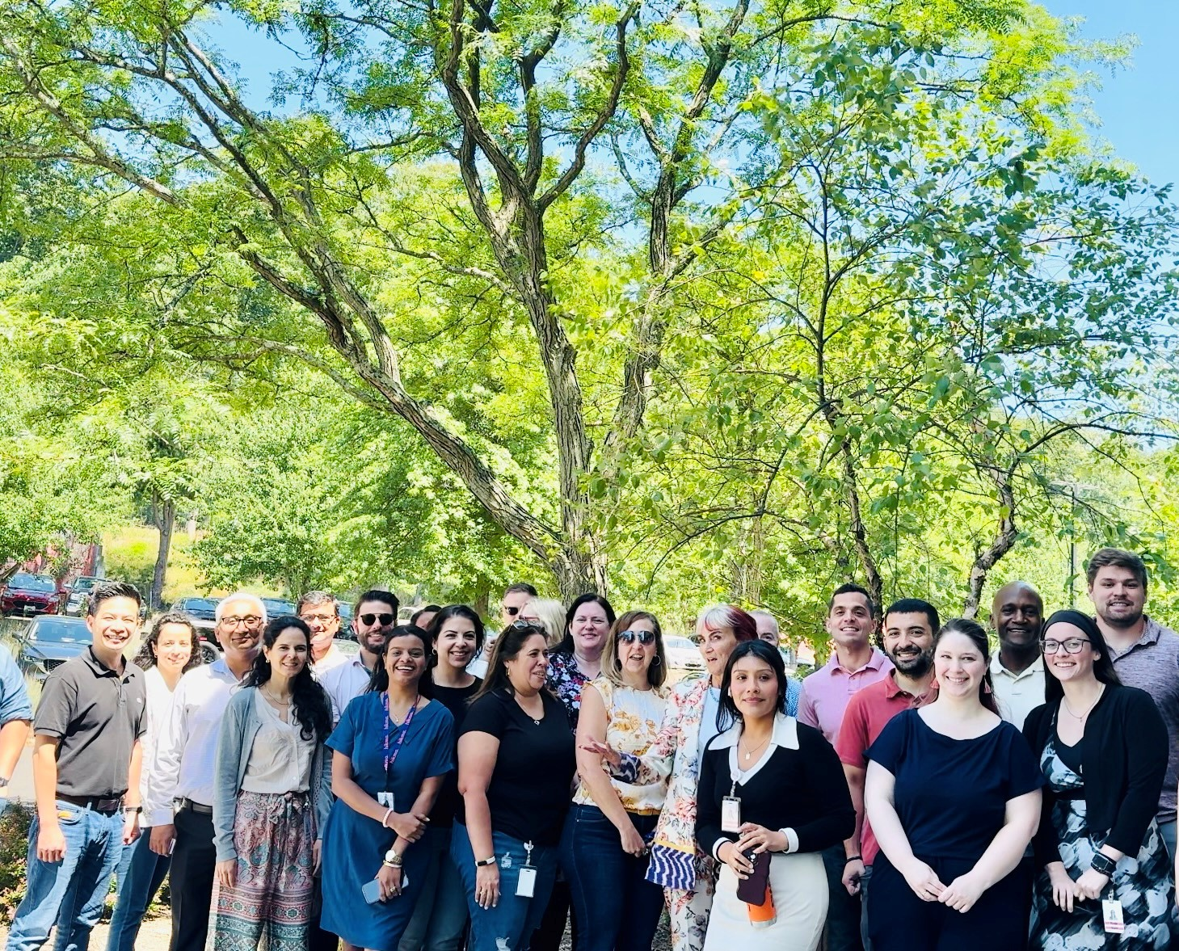

Overview
Internship Journey So Far
Hikma Commercial
Cross-Functional Collaborations
My Role:
Highlights & Participation
- CSR (Volunteer onsite and offsite)
(Lunch Break, Red Bank )
- Networking and building relations (WSC, Walks)
Generics & Injectables
Trade Operations
Supply Chain
Finance
Contracts
Warehouse
AI Innovation Drive
Cross-functional Trainings & Learnings

Slide 5
Key Learnings & Takeaways
Initial Phase
Mid Phase
Final Touchpoint Phase
Shadow Training Sessions
Minutes Of Meetings
Understanding Commercials
Key Market Affiliations
ROS, ClarusOne, WBAD
Some Abbreviations/ Jargon Terms:
NDC, FTS, SOM, API etc.
Allocations – Planned & Manual
SAP Reports
Current <4weeks file
LOMs
Spearheaded Projects
Conducted in-depth Analysis
Allocation
Direct Pricing
Indirect 3rd Party Pricing
Indirect Source Program Pricing
Billback Pricing (Direct + Indirect 3rd party Pricing)
Pricing Types
Pricing
Gained Learnings
Comprehending using examples CAH, CVS, Walmart for different pricing models
Open Bid Meetings and Pricing Strategy discussion sessions
Terminologies : Chargebacks, Rebates, Cash Disc etc.

Slide 6
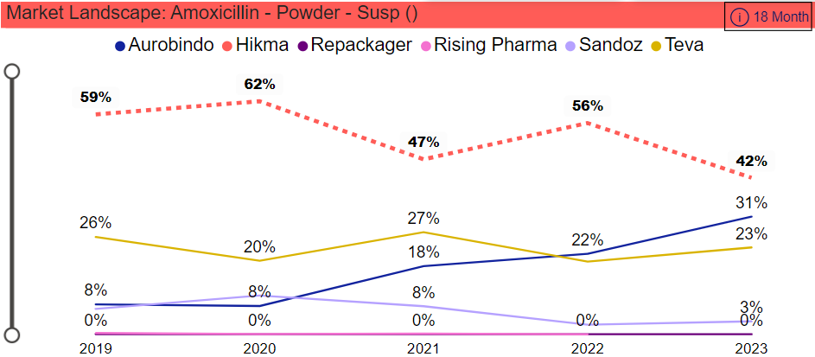
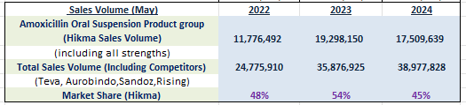



Ad hoc Project
Market Share Analysis Project
Calculating % change YoY
Market Trend Analysis for past 3 years
Top products in-depth analysis
Competitors Market Share
Decision- Making process
(N.B: For confidentiality purposes, the graphs and other analysis representations have been removed from this slide)
Data Analysis , Visualization and Performing Data Manipulation
Enhancing and Innovating

Slide 7
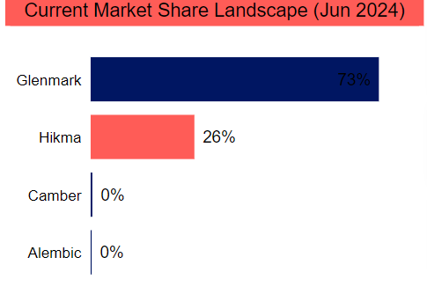
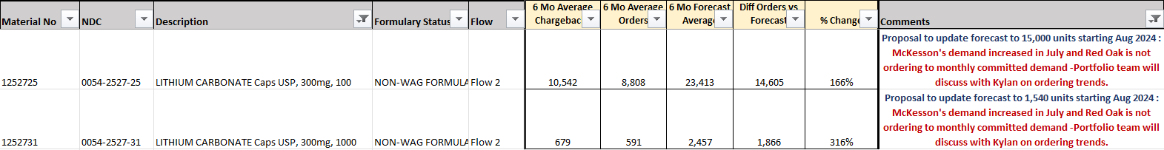
Ad hoc Project
Variance Analysis Project
(N.B: For confidentiality purposes, the graphs and other analysis representations have been removed from this slide)
Comparison Analysis : Forecast v/s Actual Orders and Chargebacks
Reflection Analysis : % change (3m & 6m rolling avg.)
Analyze and Investigate all factors impacting the product differences
Conclusion: Proposing the forecast adjustment by analyzing the drivers causing the variance

Slide 8
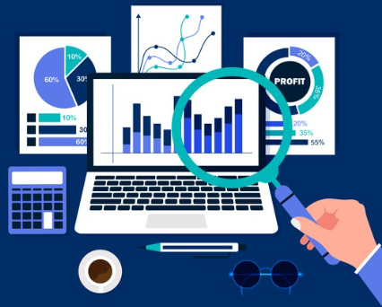


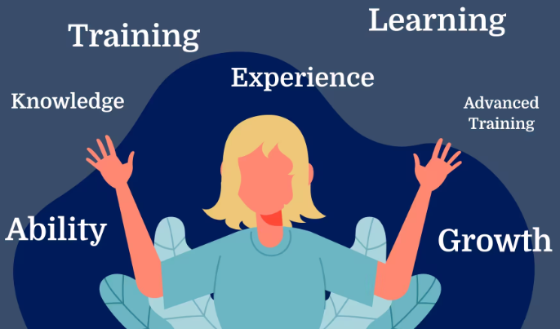



Milestones Achieved & Progressive Path
Steps towards carving the future endeavors
Personal and Professional Development and Growth
Gaining
Business Insights
Expand
Industry Knowledge
Spearheading Projects
&
Meeting Deadlines
Kaizen Is The Key
Enhance
Technical Skills
Exposure to Innovation
Experiencing
US Work Culture
Diversified
Work Environment

Slide 9
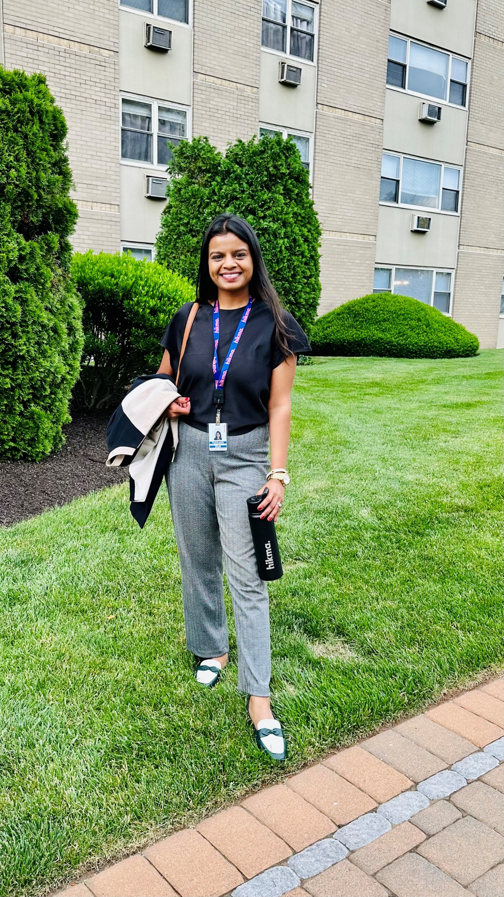

Thank You for hearing my journey ☺
I’m excited to listen yours !
LinkedIn_VaishakhiShah
GitHub_VaishakhiShah

